Slide 1
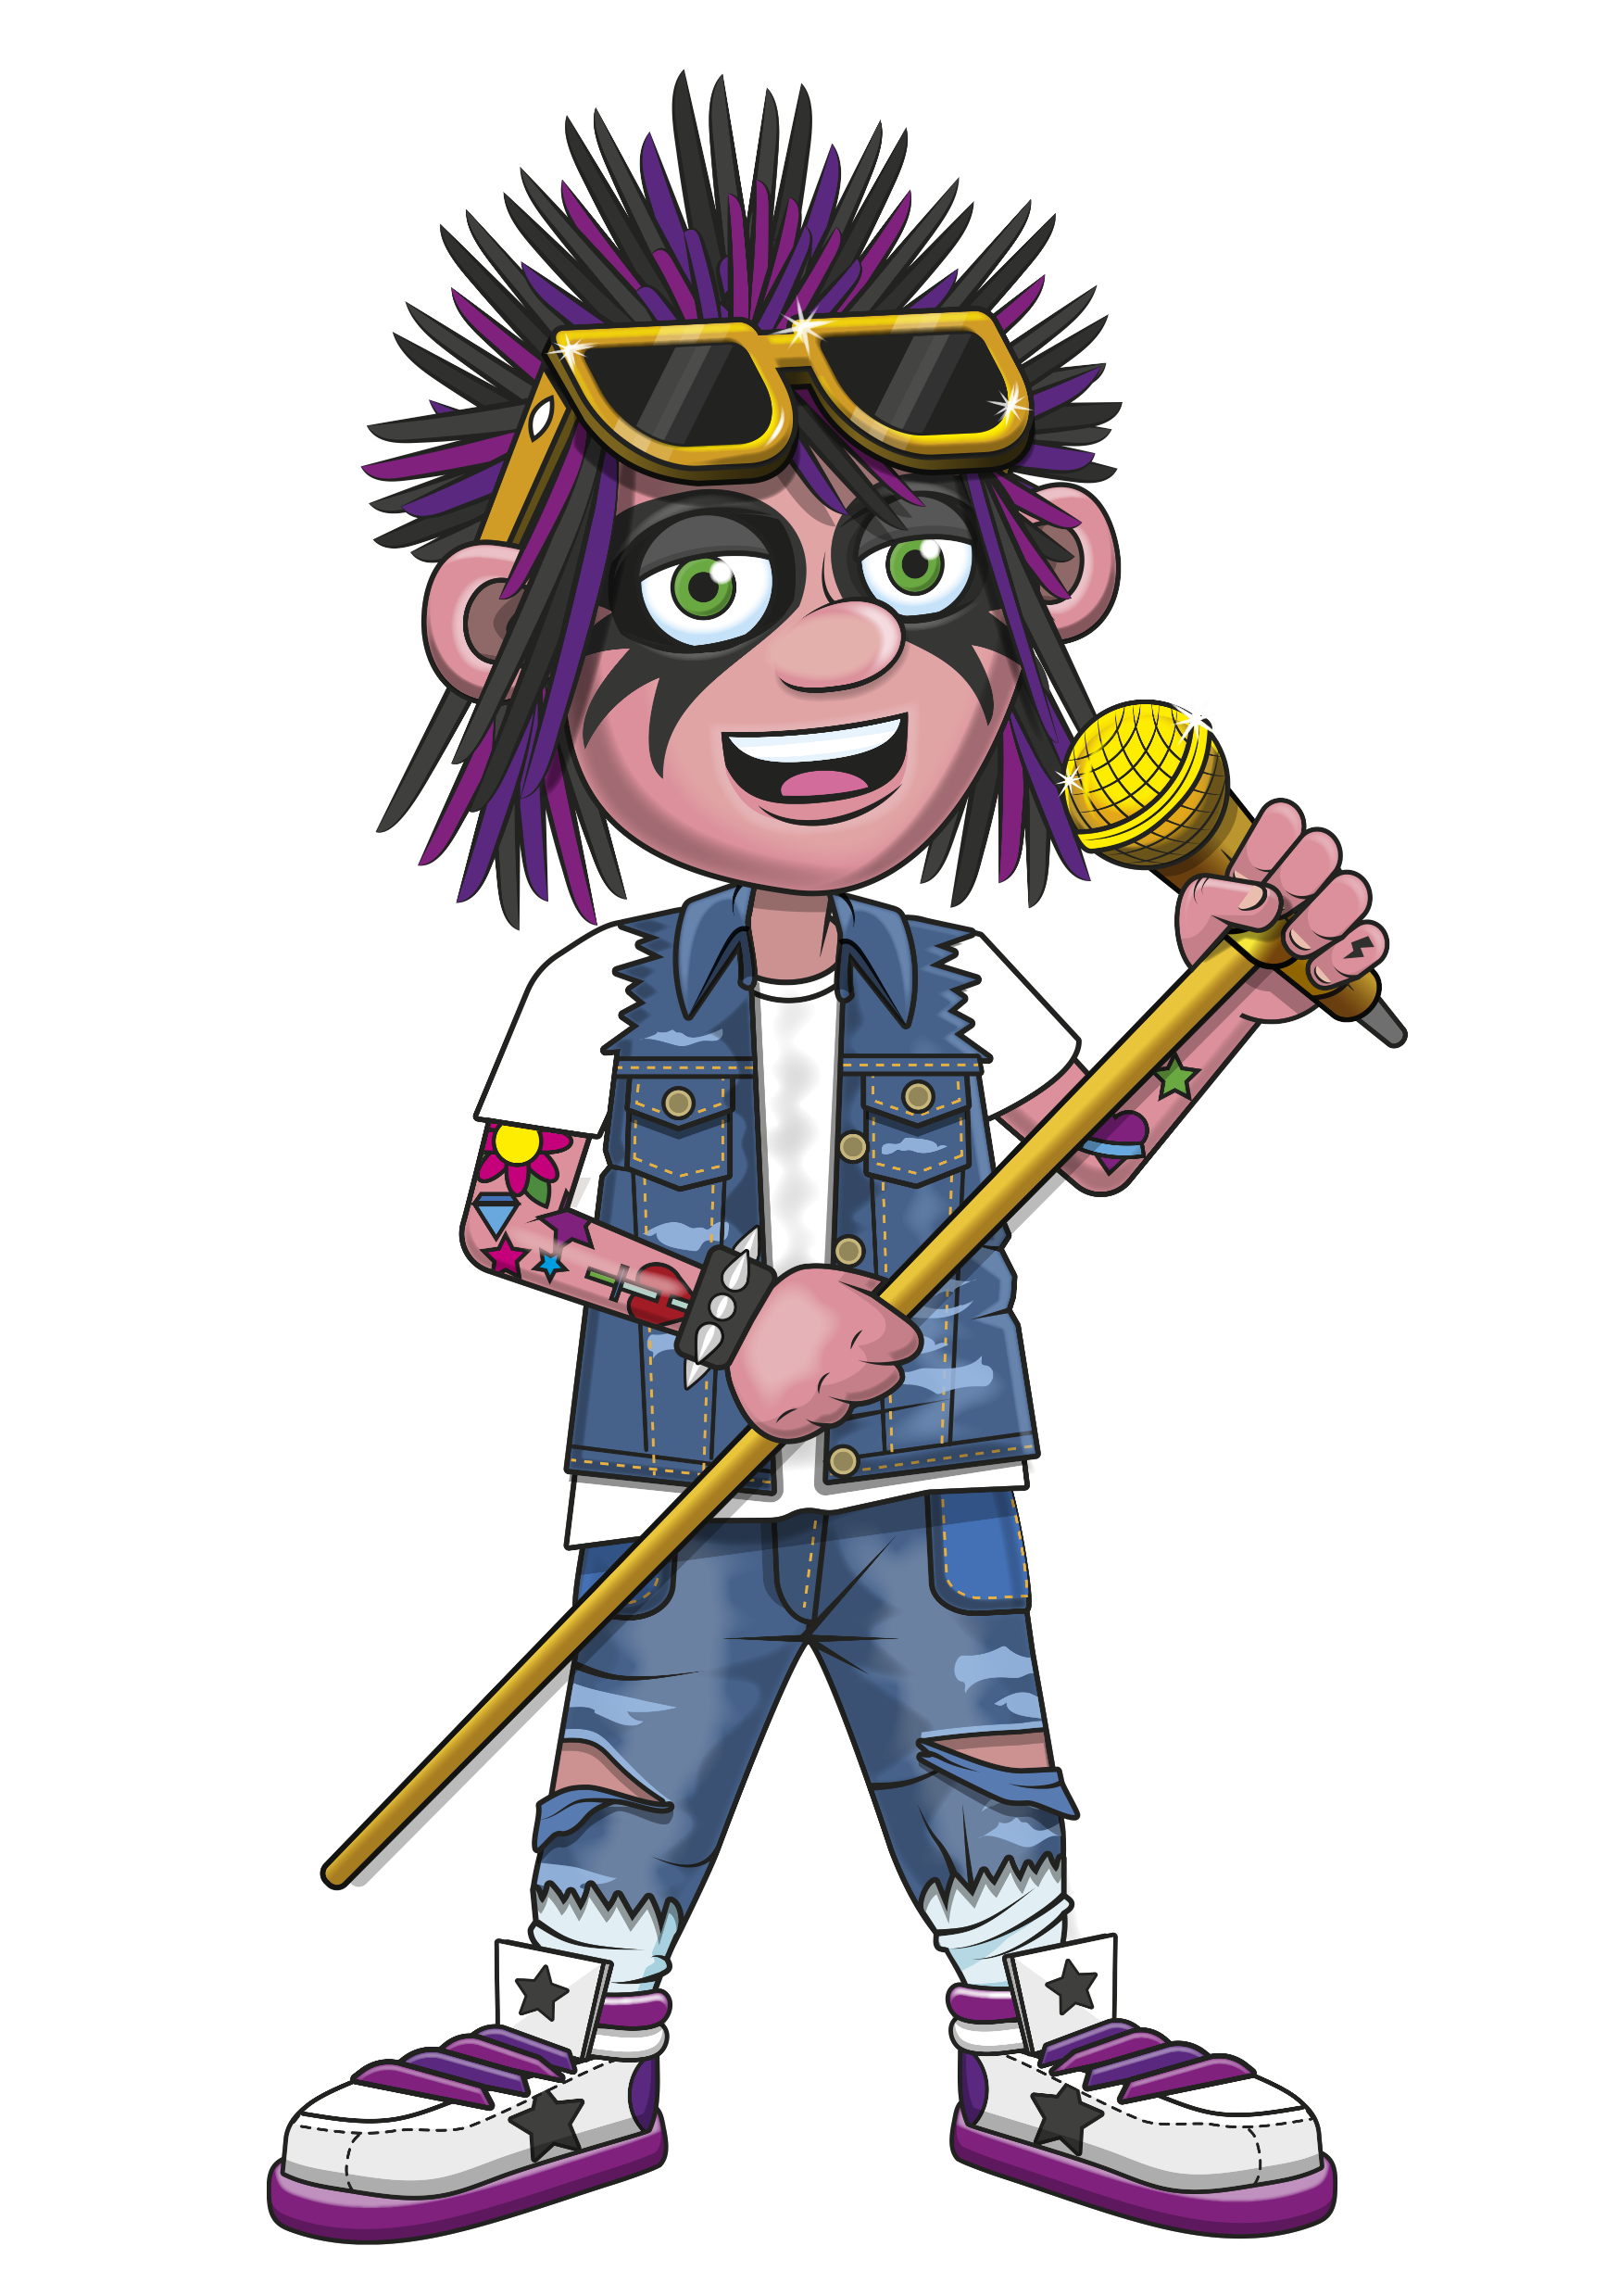

Slide 2
Warm-up
7, 14, 21, 28, 35
42, 49, 56, 63, 70,
77, 84.

Slide 3
Let’s rock and roll the 7s!

Slide 4
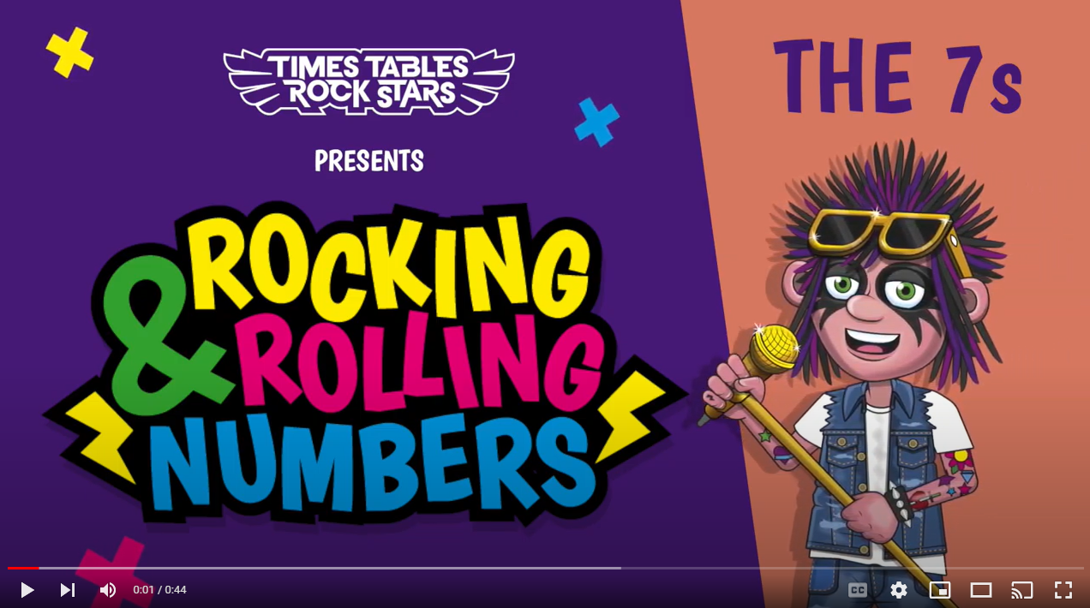
Continue with the lyrics in PowerPoint.
or
Play video

Slide 5
(The next 2 slides are the intro that you use for all tables in the ‘Rocking and Rolling Numbers’ series.)

Slide 6
Intro
Are you ready?
Ready for what?
Are you ready?
We’re ready to rock!

Slide 7
Intro
How do you want to rock today?
We’re ready to rock in a 7s kind of way!
Wooooooooooooaaaaaaaaaaaaahhhhhhh!!!
Notes:
Note that in the class’ line “We’re ready to rock in a ___ kind of way!” you’ll need to change that number to whichever table you’re rocking and rolling today.

Slide 8
(And now we get into the lyrics for this particular table.)

Slide 9
The 7s
I said,
7, 14, 21.

Slide 10
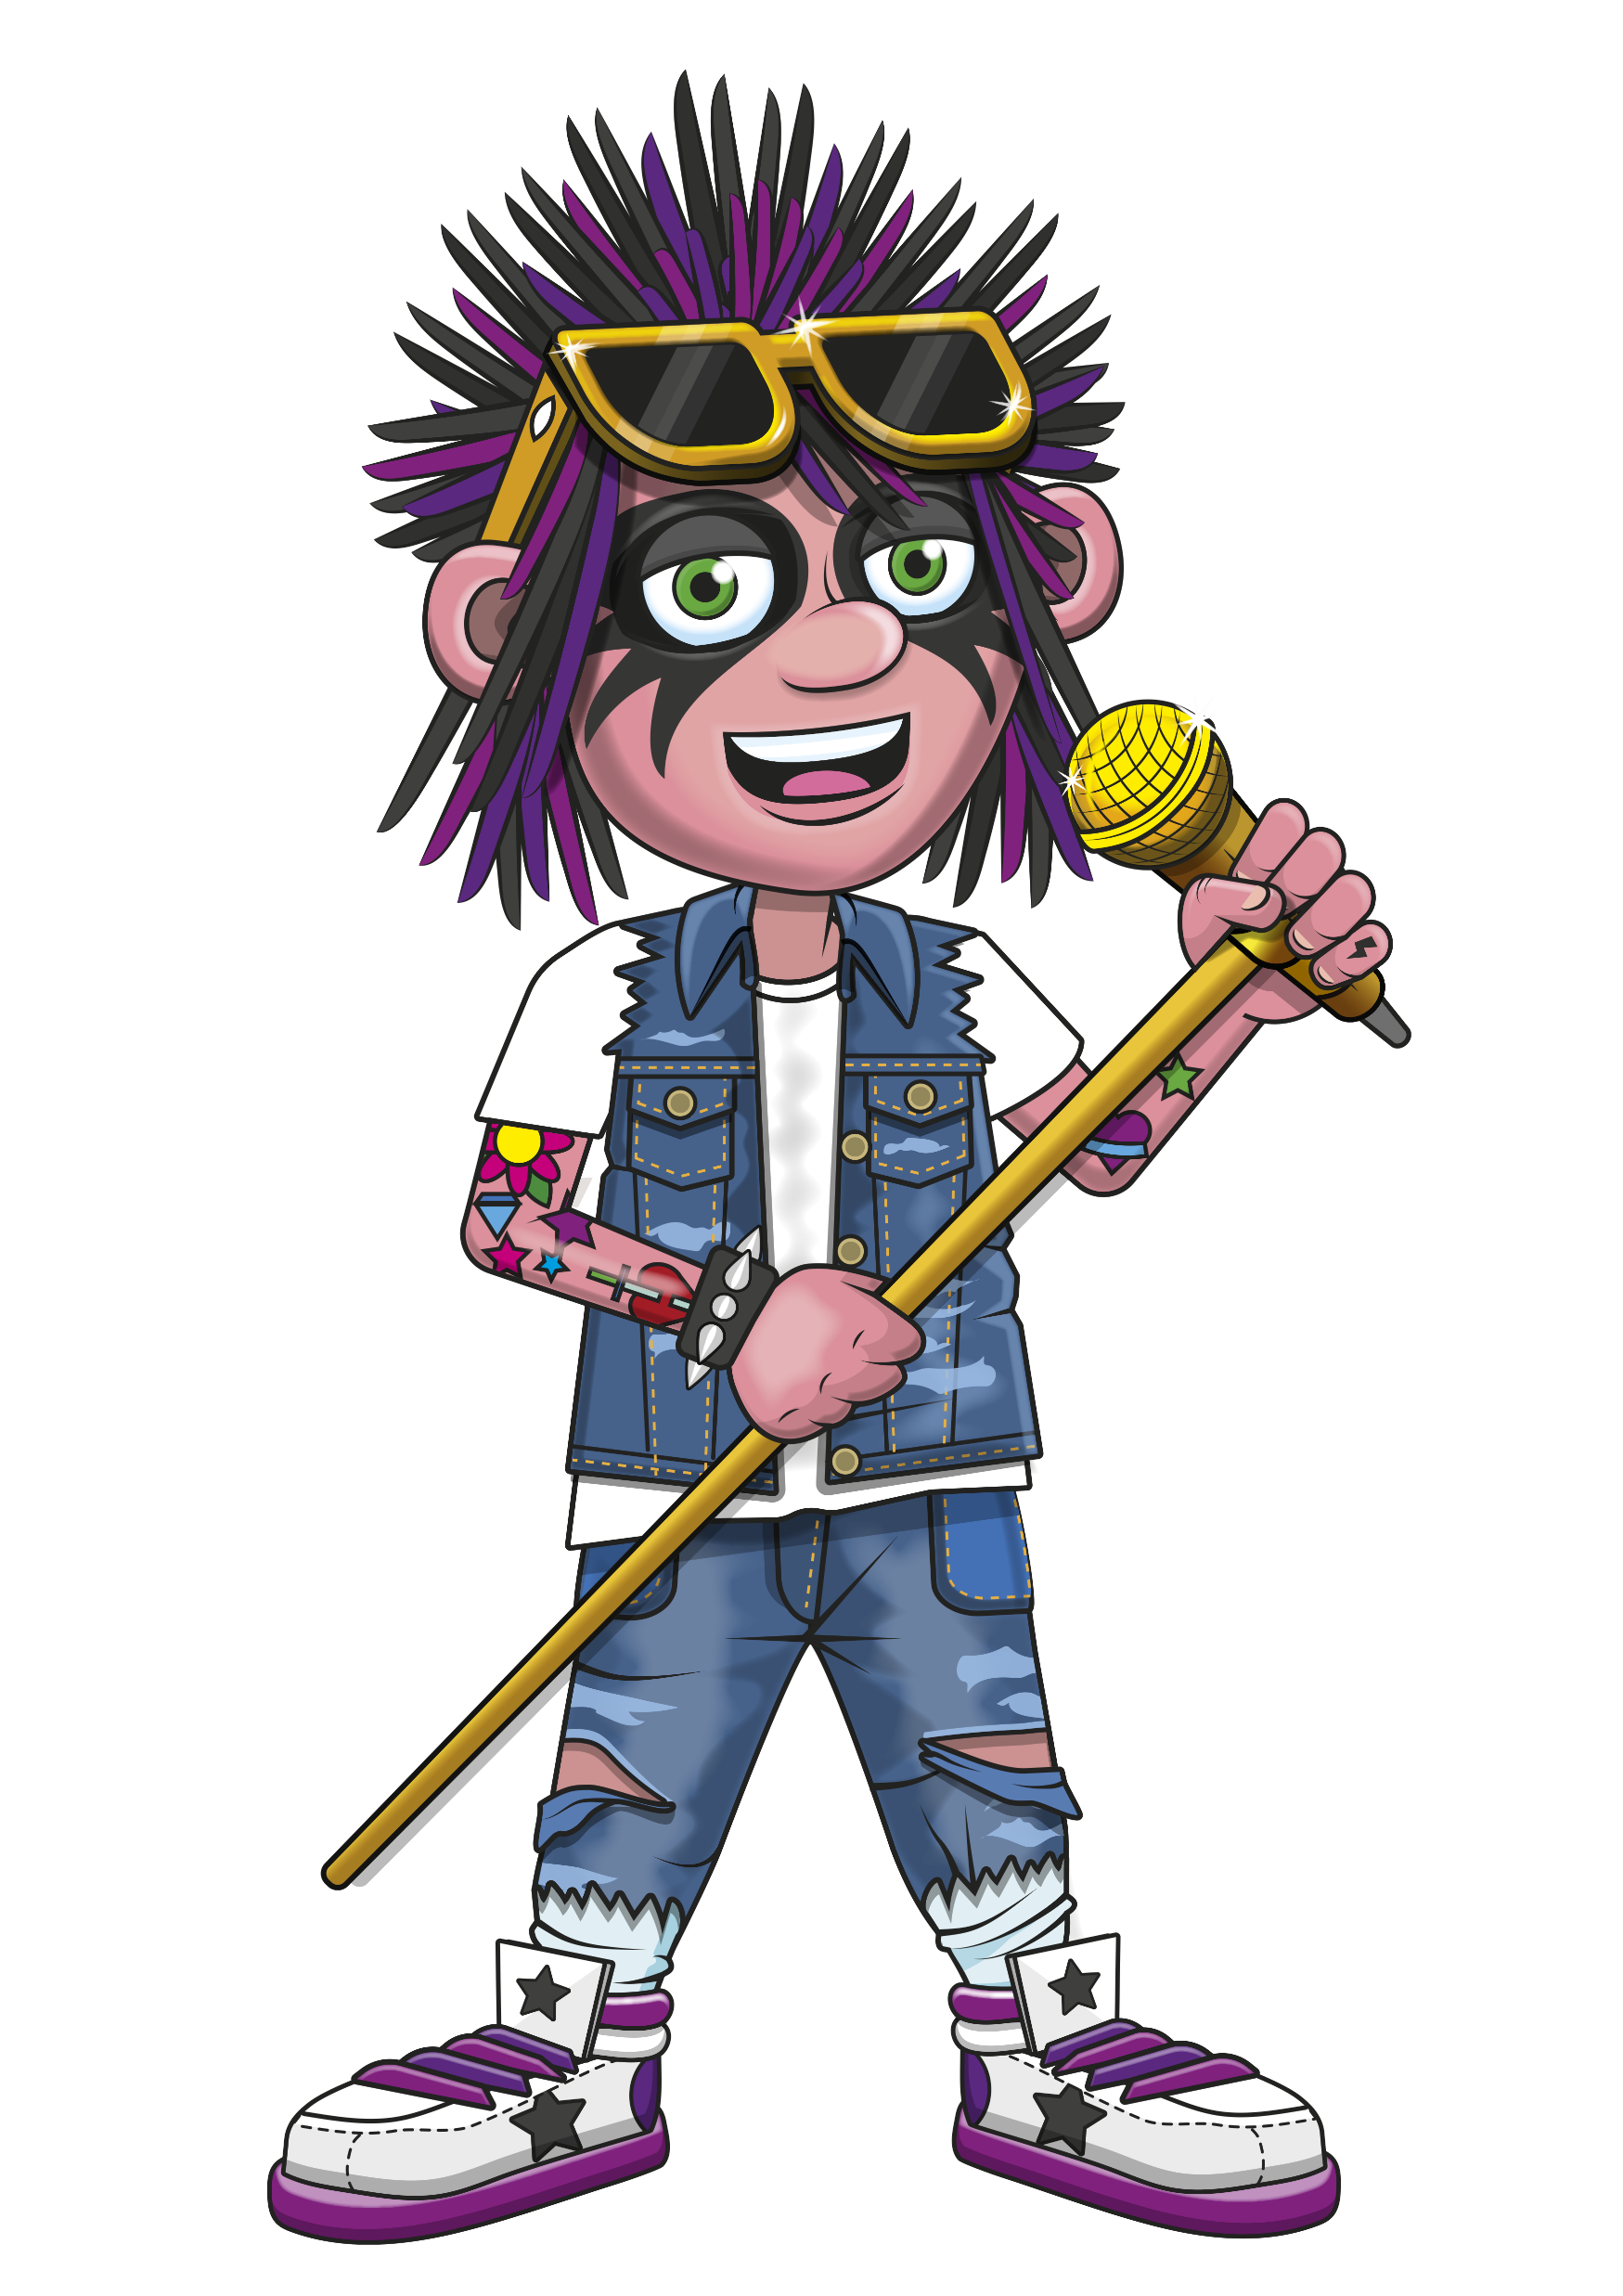
The 7s
BOOM, ROCKA BOOM, ROCKA
BOOM, ROCKA
FUN!

Slide 11
The 7s
I said,
28, 35, 42.

Slide 12
The 7s
BOOM, ROCKA BOOM, ROCKA
BOOM, ROCKA
YOU!

Slide 13
The 7s
I said,
49, 56, 63.

Slide 14
The 7s
BOOM, ROCKA BOOM, ROCKA
BOOM, ROCKA
ME!

Slide 15
The 7s
I said,
70, 77, 84.

Slide 16
The 7s
BOOM, ROCKA BOOM, ROCKA
BOOM, ROCKA
MORE!

Slide 17
(You’ve got to the end!)

Slide 18
(On the next slide, you’ve got all the lyrics in one place in case you’d prefer to see it all together.)

Slide 19
Intro
The 7s
Are you ready?
Ready for what?
Are you ready?
We’re ready to rock!
How do you want to rock today?
We’re ready to rock in a 7s kind of way!
Woooooooooaaaaaaahhh!
I said 7, 14, 21!
BOOM ROCKA BOOM ROCKA BOOM ROCKA FUN!
I said 28, 35, 42!
BOOM ROCKA BOOM ROCKA BOOM ROCKA YOU!
I said 49, 56, 63!
BOOM ROCKA BOOM ROCKA BOOM ROCKA ME!
I said 70, 77, 84!
BOOM ROCKA BOOM ROCKA BOOM ROCKA MORE!

